Slide 1
Computer graphics project

Slide 2
Project idea!
We made a simulation of the earth spinning in space with the moon also spinning around it.

Slide 3
Consepts we have been implemenetd
Texture
Geometric Transformations
Transformation
Rotation
Lighting
3D viewing (camera)
Sound

Slide 4

First, we should draw the shapes we need!
We drew the earth and the moon using the Opengl method :
gluSphere(GLUquadric* quad, GLdouble radius, GLint slices, GLint stacks)
Why not gluSolidSphere() ?
When using gluSolidSphere() we can not map a texture to the sphere, meanwhile gluSpheres first parameter (GLUquadric* quad) is an object of the class GLUquadric which allow us to add texture.

Slide 5
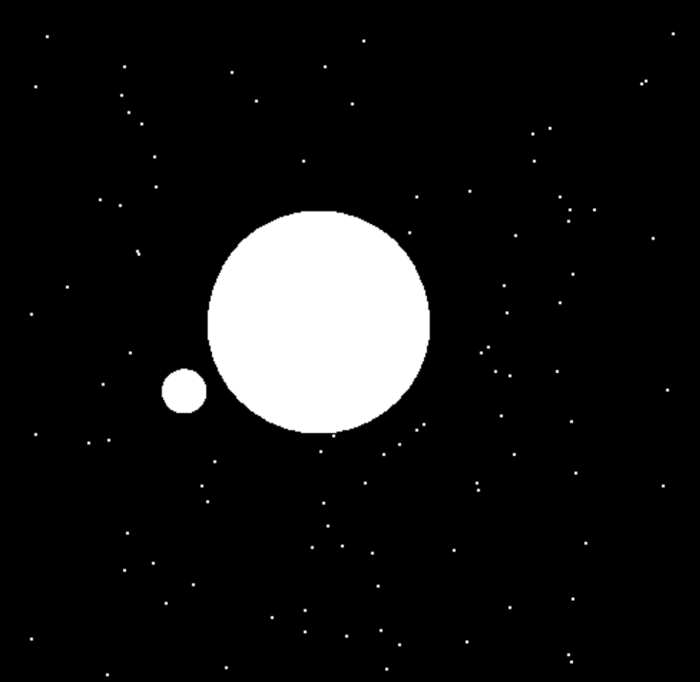
First, we should draw the shapes we need!
Now, let us add some stars
This is done by making two arrays x and y filled with random coordinates using a loop.
Later, we used these coordinates in a loop that draw a points in each coordinates.
glBegin(GL_POINTS); glColor3f(1, 1, 1);
for (int i = 0; i < 100; i++) { glVertex2f(xstars[i], ystars[i]); }
glEnd();

Slide 6
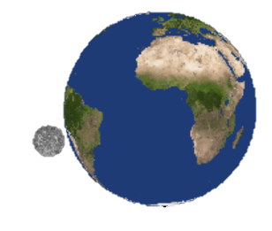
Let us add some texture!
Texture clearly have made the objects looks more realistic !
We used bmp image for the Earth and Moon and load it as a texture then map it using the method: gluQuadricTexture(GLUquadric* quad,GLboolean texture) that also take the object of GLUquadric and a Boolean value (1 or 0).

Slide 7
—How did the moon know its location relative to the Earth?

Slide 8
Geometric transformations
Transforamtion
The answer is simple!
To make the moon position be beside the earth we translate it by 2 points on x-axis, 5 points on y-axis using and 0.5 points on z-axis using:
glTranslatef(2.0 , 5.0 , 0.5)
before translating the Moon, it was not clear in the image!

Slide 9
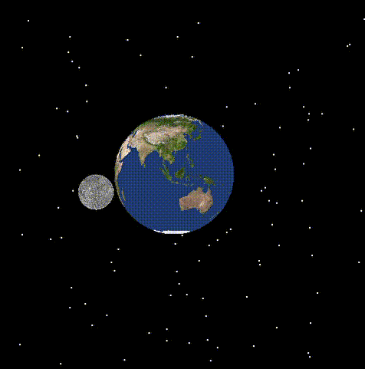
How about adding some motion!
—How did we obtain this motion? And how is the moon rotating in an ‘orbit’ around the earth?

Slide 10
Rotation
Geometric transformations
The answer is also simple!
To make the planet rotate around itself, we made it rotate around the z-axis with increasing angle starting from 0 until it is 360 then reset to zero again using an if statement and increment in the play function.
We also rotate the earth about y-axis with 90-degree angle to adjust the face of sphere that is displaying on the screen.

Slide 11
How about adding some motion!
—How did we obtain this speed of rotation?

Slide 12
glutTimerFunc(25, play, 0);
Geometric transformations
To control the speed of rotation we used gluTimerFunc() to cause some delay in play function, after updating the rotation value of Earth and Moon, by 25 milliseconds.

Slide 13
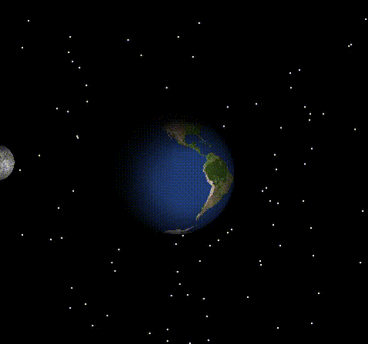
This can be even prittier! By adding light
We added the sun light on the right of the scene to light up both the Earth and the Moon with shininess of 8.
We used this matrices to create our sun light:
GLfloat light_position[] = { -8, 5, 10, 1.0 };
GLfloat shininess[] = { 8 };
GLfloat light_ambient[] = { 0.0, 0.0, 0.0, 1.0 };
GLfloat light_specular[] = { 1.0, 1.0, 1.0, 1.0 };
GLfloat mat_specular[] = { 1.0, 1.0, 1.0, 1.0 };

Slide 14
curiosity is what makes humans special!
How does this scene look from another prespective?

Slide 15
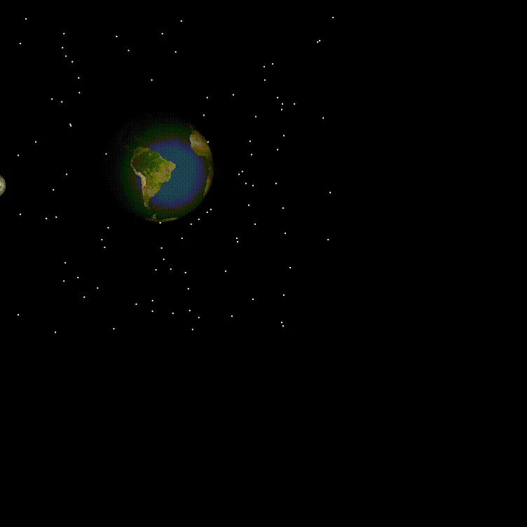
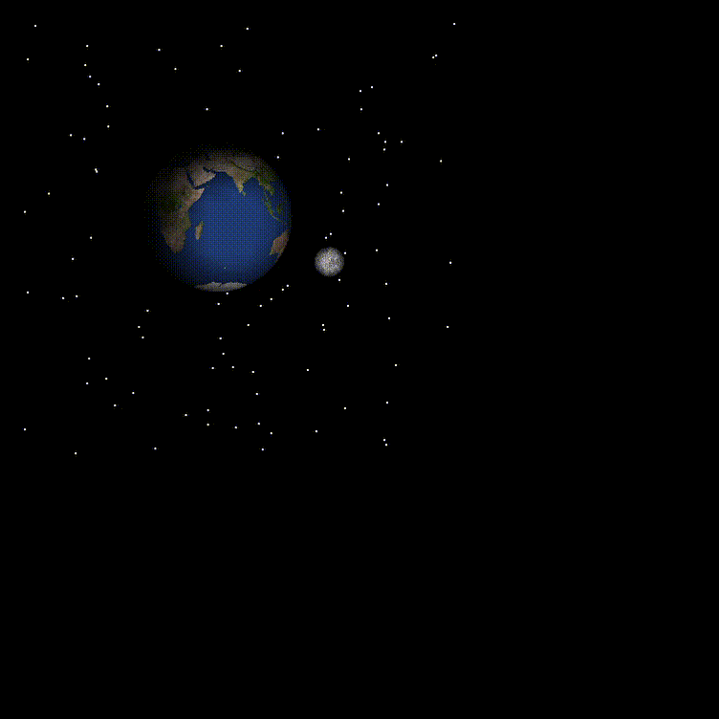
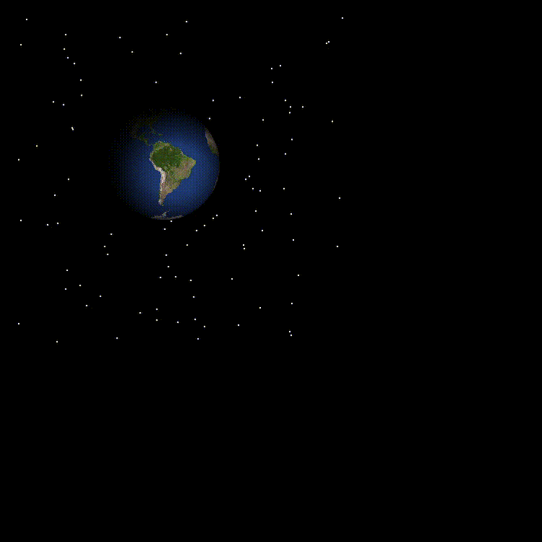
3D viewing (camera)
2.Up or Down
We now can see the poles!
1. Closer or Farther
Look how impressive our planet is!
3. Right or left
We can fully see the dark and bright side of earth.

Slide 16
Here in the outer space things are quite
The space agency used instruments on several probes to record the sound waves that it can barely catch from different planets for us to hear their sounds!
So, what is the earth sound?

Slide 17
Here in the outer space things are quite
sndPlaySound(TEXT("Space Sounds.wav"), SND_ASYNC | SND_LOOP);
we used wav sound file for the space sound and add it by using the method : sndPlaySound(); which have the values SND_ASYNC and SND_LOOP for paly the sound repeatedly .
So, what is the earth sound?

Slide 18
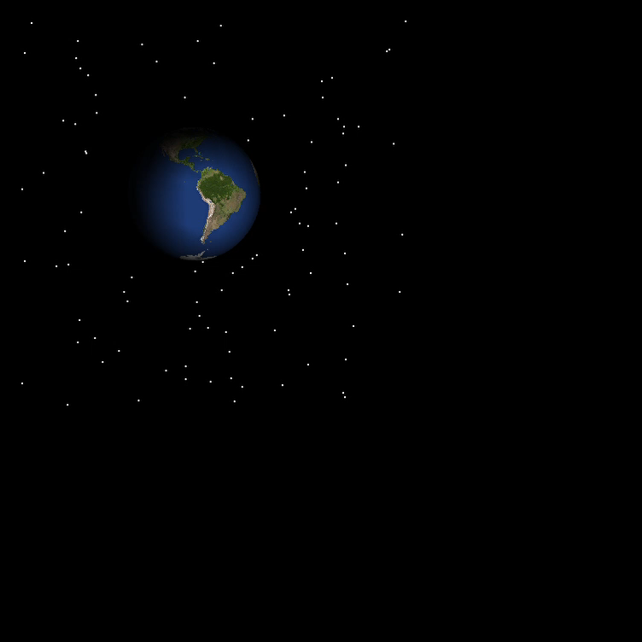
Sound

Slide 19
Thank you!
This was an interesting journey, but we must take off
Tasneem Alzahrani 439008642 serial#37 group:3
Jumana Alwafi 439000464 serial#18 group:1
Halah Qasas 439002065 serial#17 group:3
Rawan Abdu 439010062 serial#37 group:2
Reem Alshareef 439006592 serial#32 group:3
ManarAlemam 439004660 serial#25 group:3

